Slide 1
Mindful Breathing & Concentration
Straight back, folded legs if you are sitting on a matt or cushion, or legs grounded if on a chair
Chin slightly tugged in or dropped to feel at ease
Hands resting on the knees or thighs with palms upwards
Eyes slightly opened to see barely your knees or closed
Tongue lightly touching the upper palette
Lips closed, teeth not biting
Shoulder relaxed

Slide 2
Quiet Meditation
Breath in deeply and breath out slowly for three times
Look at the lotus flower for 30 seconds with full concentration, close you eyes and focus in your mind the follower and try to discover its being
Gently remind your mind when floating away to come back to you focus

Slide 3
Private victory is when we learn self mastery and self-discipline
Public victory is when we build deep, lasting, highly effective relationships with other people

Slide 4
Public Victory
There is plenty out there for everyone, and more to spare: Mutual benefit or win-win
I listen with the intent to understand and not with the intent to reply: Mutual understanding
Together we can create a better way, a higher way: Creative Cooperation

Slide 5
There is plenty out there for everyone, and more to spare
Effective, long term relationships require mutual respect and mutual benefit
Balance courage and consideration
Seek mutual benefit & Create win-win agreement
Build win-win system

Slide 6

Balancing Courage & Consideration
Remember to think win-win in situations of conflict, in long term relationships, and in interdependent situations
Win-lose: Common scripting Authoritarian approach Uses position, power, credentials, possessions or personality to win | Win-win: Seeks mutual benefit Cooperative, not competitive Listen more, stays in communication longer, and communicates with more courage
Lose-Lose: Dependent person No win because nobody benefits Long term habit of giving it up | Lose-win: Voices, no standards, demands, expectations Quick to please or appease Buries a lot of feeling
Low--- Courage ---High
You don’t have to blow out the other person’s light to let your own shine. Bernard M. Baruch
Low--- Consideration--- High

Slide 7
Guide to creating a win-win agreement
Elements of effective win-win agreement | Explanation | Parent-child example
Desired Results | What’s the end in mind? What are the outcomes I want | Homework done each day; better grades Stop the nagging
Guidelines | What rules do I follow? What are the guidelines for accomplishing the results? | Can’t watch TV or play on computer until homework is done Reminder no more than once a day to do homework
Resources | What resources do I have to work with (pp, tools, technology, m3, etc) | Parents, tutors, after school programmes
Accountability | How will we measure how well it’s going | Parents signs off on homework every day, checks school assessment regularly
Consequences | What are the rewards of achieving the outcome? What art the consequences of not achieving the outcome? | Positive: Feel better about self, dinner and movie with parents Negative: if unsuccessful winter tutorial classes

Slide 8
Emotional Bank Account (EBA)
Deposits | Withdrawals
Seek first to understand | Assume you understand
Show kindness, courtesy, respect | Show unkindness, discourtesy, disrespect
Keep promises | Break promises
Be loyal to absent | Be disloyal, badmouth
Set clear expectations | Create unclear expectations
Apologize | Be proud and arrogant
Give feedbacks (I messages) | Give no feedback or evaluate character (you messages)
Forgive | Hold grudges

Slide 9
Trades of Win-Win People
Highly effective people strive for win/win transactions.
They try to ensure that all the parties are better off in the end.
They know that any other kind of transaction is destructive, because it produces losers and, therefore, enemies and bad feelings, such as animosity, defeat and hostility.
They know a win-win mindset can help us multiply our allies.

Slide 10
I listen with the intent to understand and not with the intent to reply
To communicate effectively, we must first understand each other
Diagnose before your prescribe
Listen empathically
Seek to understand form other’s perspective

Slide 11
Listening for mutual benefit
Autobiographical responses (interpreting from our own frame of reference, experience and motive)
Advising (giving counsel, advice, and solution to problems)
Probing (asking question from our own frame of reference)
Interpreting (explaining another’s motives and behaviour based on our experience, trying to figure people out)
Evaluating (Judging, and either agreeing or disagreeing)
Listen Empathically (reflecting what a person feels and says in your own words – stepping into other person’s shoes)
Reading the signs (7% goes on the words we use, 55% on facial expression and body language, and 38% on how we say word, tone, voice, style)
Helpful languages (You must have felt…, you sound…, What I am hearing is.. ., As I get it, you feel…
One friend, one person who is truly understanding, who takes the trouble to listen to us as we consider our problem, can change our whole outlook on the world. Dr Elton Maya

Slide 12
Trades of Cooperative People for Relationship Building
To develop win/win relationship, we must find out what the other parties want, and what winning means to them.
We must always try to understand what the other people want and need before we begin to outline our own objectives.
We must not object, argue or oppose what we hear.
We must listen carefully, and think about it.
We must try to put ourselves int he other party’s shoes.

Slide 13
Together we can create a better way, a higher way
The whole is greater than the sum of its parts
Value and celebrate the difference
Practice creative cooperation

Slide 14
What is Synergising
Synergising is a result oriented positive energy; examining, exploring, and seeking different perspectives openly enough to alter or complete your paradigm; win-win cooperation; having an agreed upon a goal in mind; taking a disciplined process.
Four types of interaction (synergy- transformation, compromise - transaction, defensive and hostility - contention)

Slide 15
Practice Creative Cooperation
Synergising is a creative process that explores new possibilities to benefit all parties involved. At its best it is a process that results in the Third Alternative
Your way
Reflect Viewpoints
Check Willingness
Third Alternative
My way
Create New Ideas
Third alternative is created when you have change of hearts, feel new energy and excitement, see things in a new way, feel the relationship has transformed, and end up with an idea that is better than what either of us started with.

Slide 16
Trades of Collaborative People
Cooperation and communication are the two legs of a synergistic relationship.
They believe and practice that effective synergy depends on communication.
They listen, reflect and respond reflexively.
They do not react defensive, authoritarian or passive or oppose to go along - but they actively cooperate.

Slide 17
Private victory is when we learn self mastery and self-discipline
Both of the victories will fail if we do not nurture the goose that lays the golden eggs and not focus on getting the golden eggs
Public victory is when we build deep, lasting, highly effective relationships with other people

Slide 18
To maintain and increase effectiveness, we must renew ourselves in body, heart, mind and soul
Renew regularly in the four dimensions
Be strong in the hard moments

Slide 19
Four Dimensions
Physical:
Enough sleep
Setting health and fitness goals & ensure to include flexibility, strength and cardiovascular endurance training
Include vegetable, fruits, whole grains, fibre and lots of water in your diet
Reduce stress by being in Quadrant II
Social/Emotional:
Continual repair relationship and increase EBA
Value the difference (opportunities to synergise)
Practice empathetic listening
Widen you circle of friends
Forgive yourself and others
Build family relation both immediate and extended
Let go damming and competitive feelings
Mental:
Keep a journal to work out your problems
Read veraciously
Develop a hobby
Continue your education and train your mind to stand apart and examine its own paradigm
Write gratitude notes each day
Keep a journal of one good thing that happened to you each day
Spiritual:
Create, review, revise you personal statement and commit to total integrity for priorities
Watch, listen, and enjoy the world of nature
Read inspirational literature
Listen to inspirational, uplifting music
Service in community (give your time, money and service)
Practice spiritual worships

Slide 20
Be Strong in the Hard Moment
Getting up in time (mind over mattress)
Controlling your temper and not saying any unkind thing
Disciplining yourself to eat healthy
Sticking to your reading regimen even when you are busy
Example:
Pick one of the four renewal activities
What obstacles or hard moments might you encounter as you do this activity?
How will you overcome these obstacles or hard moments?

Slide 21
Trades of Renewing People
They take care of their bodies with a program of exercise that combines endurance, flexibility and strength.
They nourish their souls with prayers, meditation , or perhaps by reading great literature or listening to great music.
They make mental repairs by changing bad habits, such as the habits of addicted to mobiles.
They work to develop their hearts, their emotional connections and engagement with other people.

Slide 22
Understanding the Voice
Voice is the unique personal significance each of us offer, and can bring to bear at work.
The 8th habit is all about moving from effectiveness to greatness.
Finding our unique voice means fulfilling our innate potential.
Finding our voice, involves the four elements of a whole person: mind, body, heart and spirit.

Slide 23
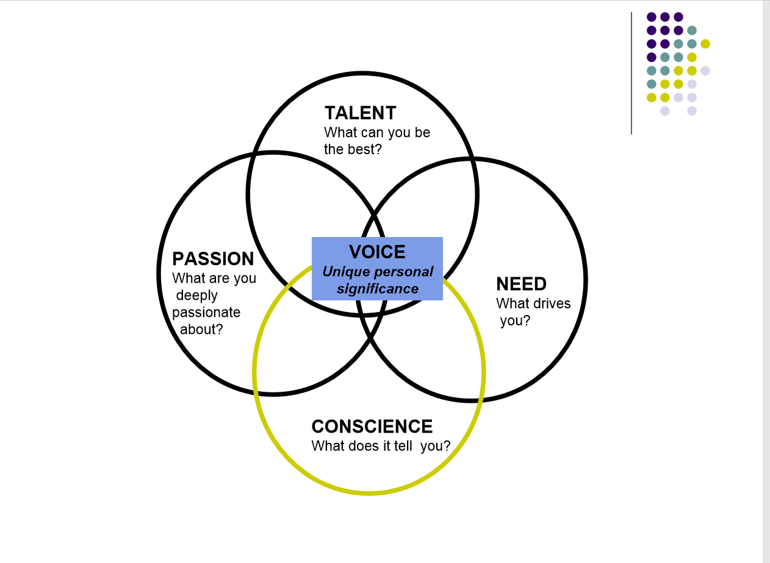

Slide 24
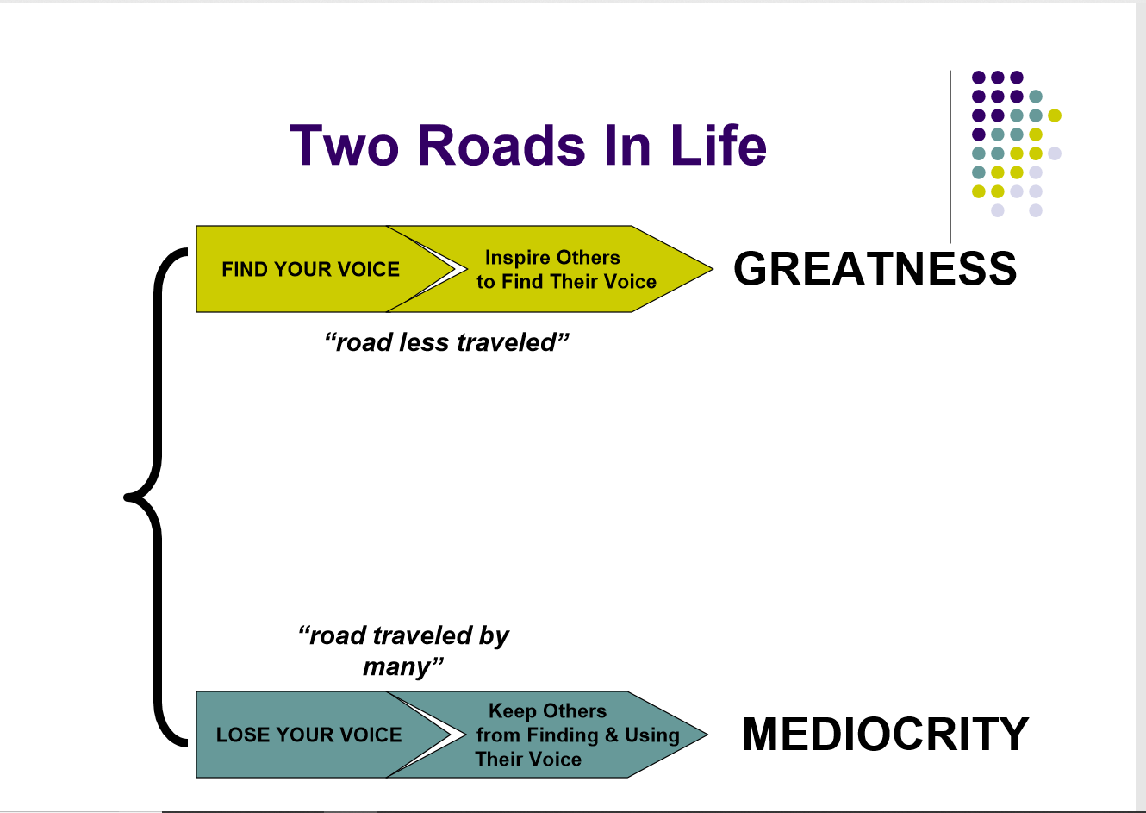

Slide 25
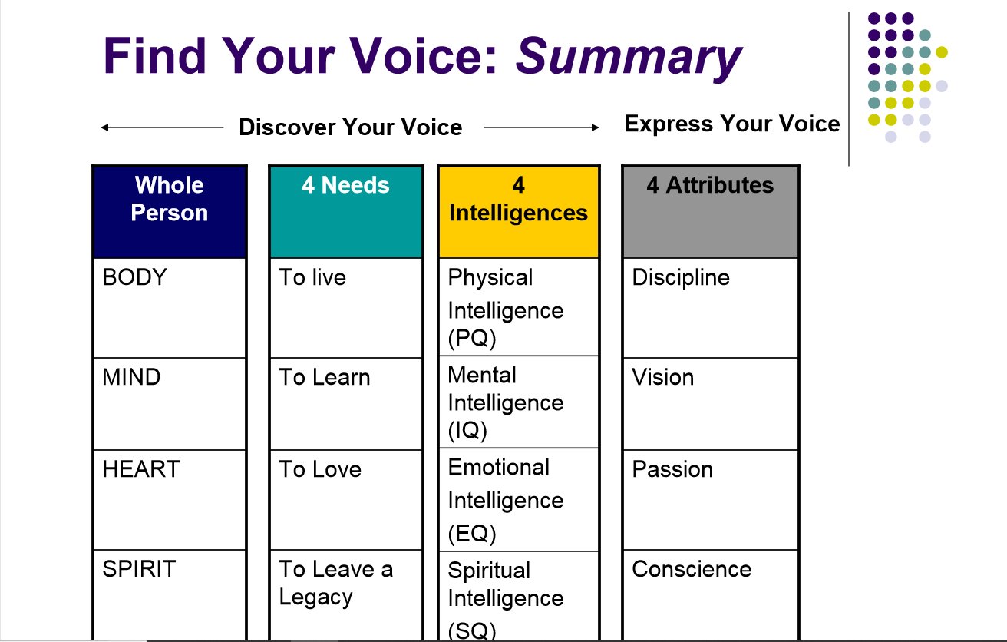

Slide 26
Four elements of the whole person
Mind = Vision When the mind is fully developed we gain vision, the ability to discern the highest potential in people, institutions, causes and enterprises.
Body = Discipline We need discipline to transform vision into reality. Discipline comes by combining vision and commitment.
Heart = Passion When we develop a wise heart we will feel the passionate fire of conviction, the flame that sustains the discipline needed to achieve the vision.
Spirit = Conscience Developing our mental identity will lead us towards knowing the right fork in the road, toward an inward moral compass that will guide us.

Slide 27
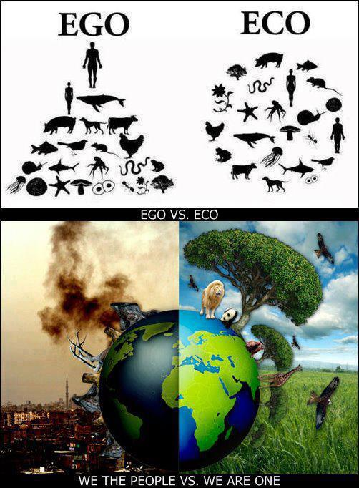
GDP
GNH

Slide 28

Tashi Delek Zhu!
Happiness is here and now, I have dropped my worries, nowhere to go, nothing to do, and I am not in a hurry.
Happiness is here and now, I have dropped my worries, somewhere to go, something to do, but I am not in a hurry.
May you be well and happy always
May you find happiness in what you do
May you bring happiness to the lives you touch
May you be the northern star for yourself, family, friends, society and the world.

Slide 29
Journaling
Identify an important relationship. What is your EBA with the person (mark on a scale of 1-10 mark, ten being extremely high and 1 being extremely low)
Describe 3 things the person you identified would consider deposits
Describe 3 things you think the person you identified would consider withdrawals.
EBA applies for and to all walks of life that you come in contact with

Slide 30
Journaling
Describe a time when someone didn’t listen to you before prescribing an answer
How did you feel?
When do you most often fail to listen to others?
What gets in the way of listening effectively?
Diagnose before you prescribe

Slide 31
Journaling
Draft a win-win agreement from a situation from your own perspectives using the five elements
Identify an area in your own life where you feel you may have created or are supporting a win-lose system (e.g. in your family, in a relationship, within a team)
What one action will you take within your circle of influence to improve the system?

Slide 32
Journaling: Value and celebrate the difference
Essence of synergising:
We not only tolerate or accept difference but we celebrate them.
We get threatened by difference in opinion, perspective or background. But once we identify a common purpose, we seek out and learn from the differences.
Discuss a situation from your work or personal life which valuing the difference produced greater results than what you could have produced otherwise.
What differences were valued?
What did you say or do that showed you valued the difference?
What did you learn from the experience?
What effect did valuing the difference then have on the way you treat others now?
Together we can create a better way, a higher way

